Slide 1
Computer Communication & Networks
Week 4
Datalink Layer: Datalink control and protocols
GitHub - AhmadNawaz110/CE313-Computer-Commincation-and-Network-Spring-2026-
Engr. M Ahmad Nawaz
Engr.ahmad.nawaz@giki.edu.pk

Slide 2







































IEEE STANDARDS
In 1985, the Computer Society of the IEEE started a project, called Project 802, to set standards to enable intercommunication among equipment from a variety of manufacturers. Project 802 is a way of specifying functions of the physical layer and the data link layer of major LAN protocols.

Slide 3
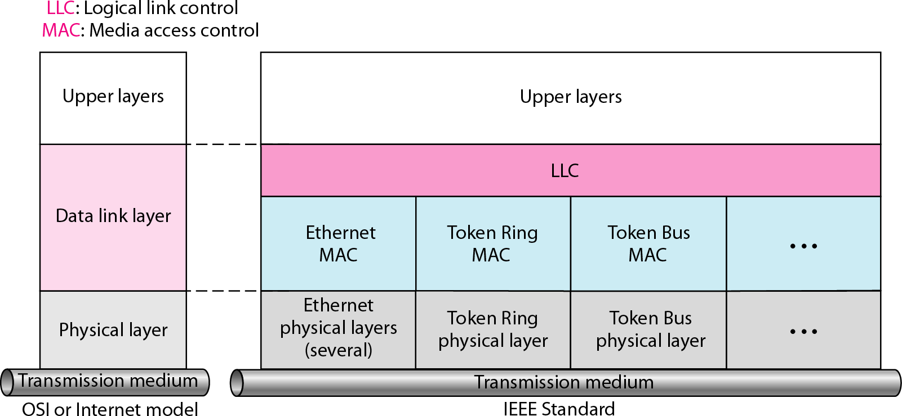
IEEE standard for LANs

Slide 4
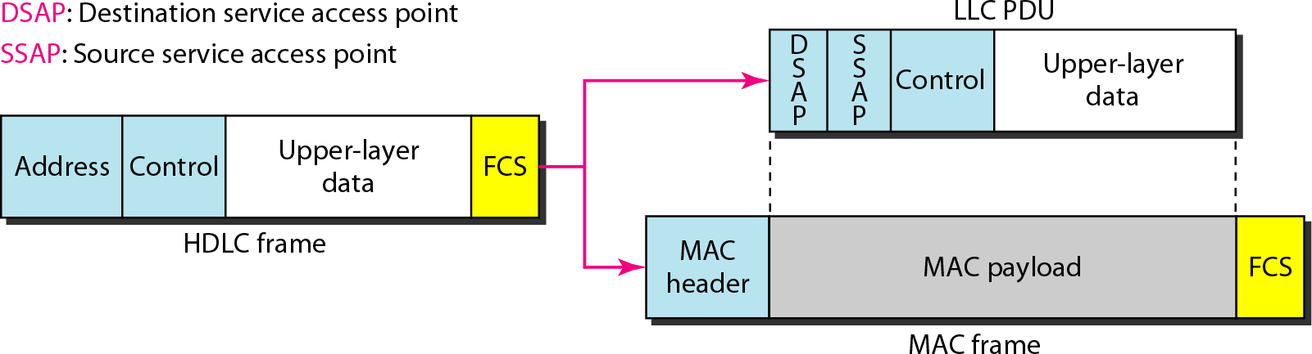
HDLC frame compared with LLC and MAC frames

Slide 5


































STANDARD ETHERNET
The original Ethernet was created in 1976 at Xerox’s Palo Alto Research Center (PARC). Since then, it has gone through four generations. We briefly discuss the Standard (or traditional) Ethernet in this section.
Topics discussed in this section:
MAC Sublayer Physical Layer

Slide 6
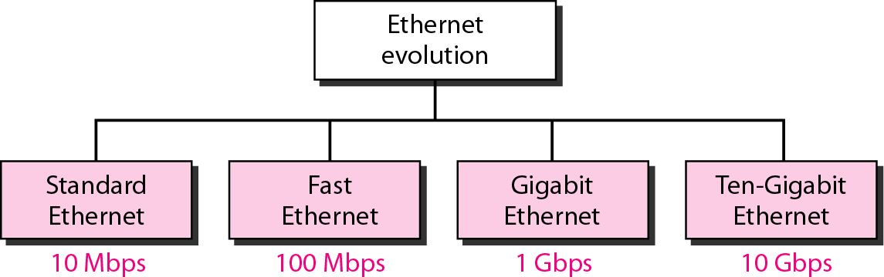
Ethernet evolution through four generations

Slide 7
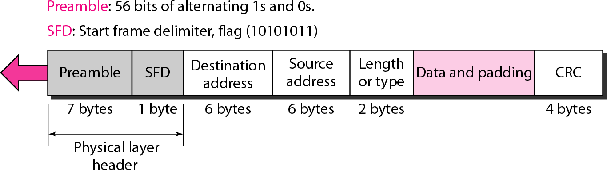
802.3 MAC frame

Slide 8
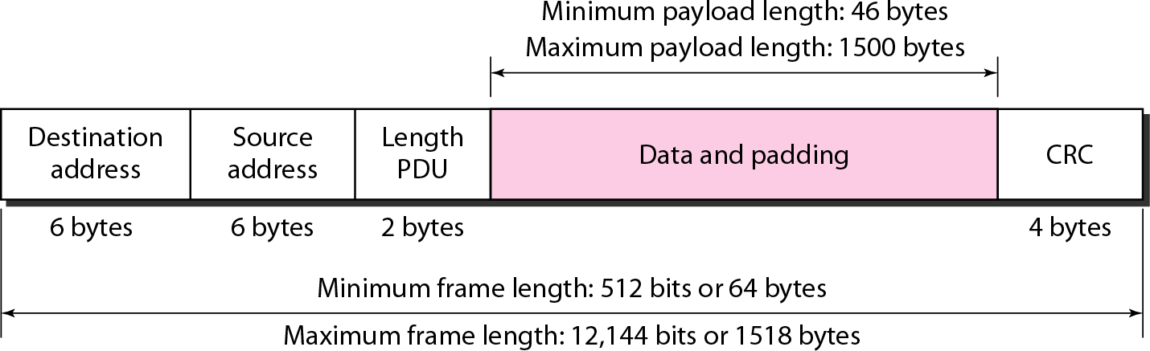
Minimum and maximum lengths

Slide 9

Note
Frame length: Minimum: 64 bytes (512 bits)
Maximum: 1518 bytes (12,144 bits)

Slide 10
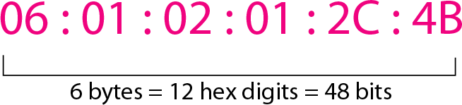
Ethernet address in hexadecimal notation

Slide 11
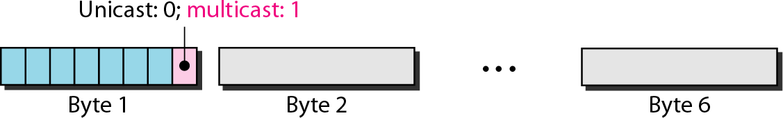
Unicast and multicast addresses

Slide 12
Note
The least significant bit of the first byte defines the type of address.
If the bit is 0, the address is unicast; otherwise, it is multicast.

Slide 13
Note
The broadcast destination address is a special case of the multicast address in which all bits are 1s.

Slide 14
Example
Define the type of the following destination addresses:
a. | 4A:30:10:21:10:1A | b. | 47:20:1B:2E:08:EE
c. | FF:FF:FF:FF:FF:FF
Solution
To find the type of the address, we need to look at the second hexadecimal digit from the left. If it is even, the address is unicast. If it is odd, the address is multicast. If all digits are F’s, the address is broadcast. Therefore, we have the following:
This is a unicast address because A in binary is 1010.
This is a multicast address because 7 in binary is 0111.
This is a broadcast address because all digits are F’s.

Slide 15
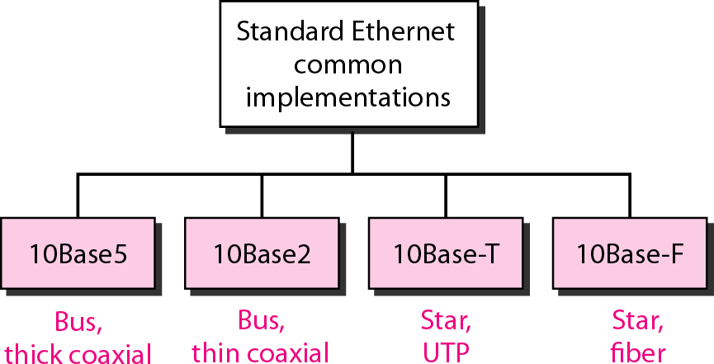
Categories of Standard Ethernet

Slide 16
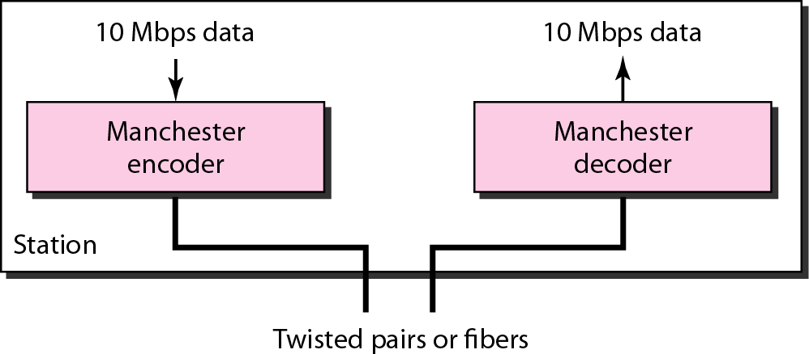
Encoding in a Standard Ethernet implementation

Slide 17
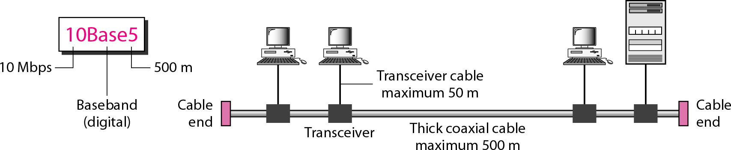
10Base5 implementation

Slide 18
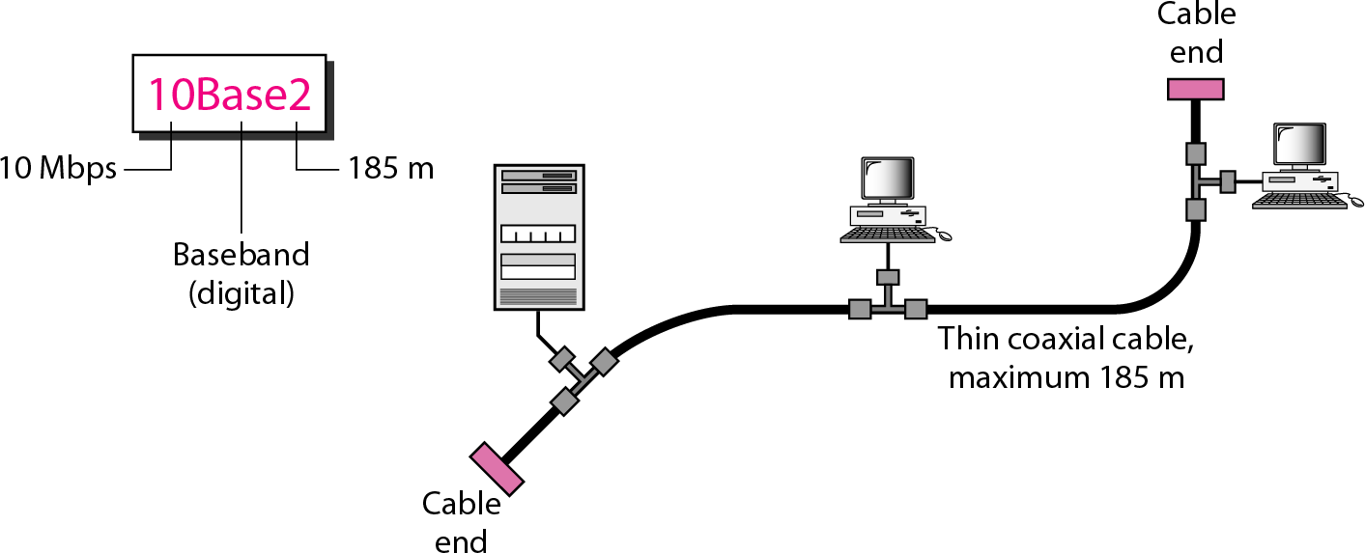
10Base2 implementation

Slide 19
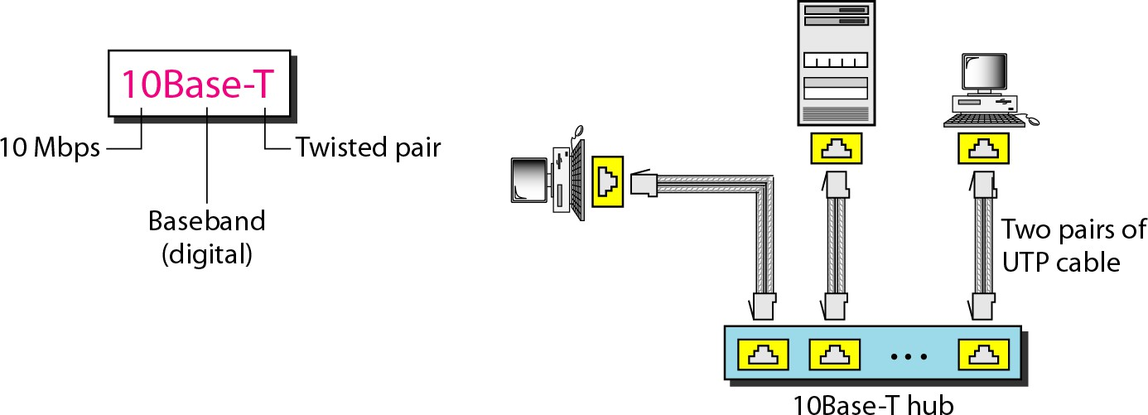
10Base-T implementation

Slide 20
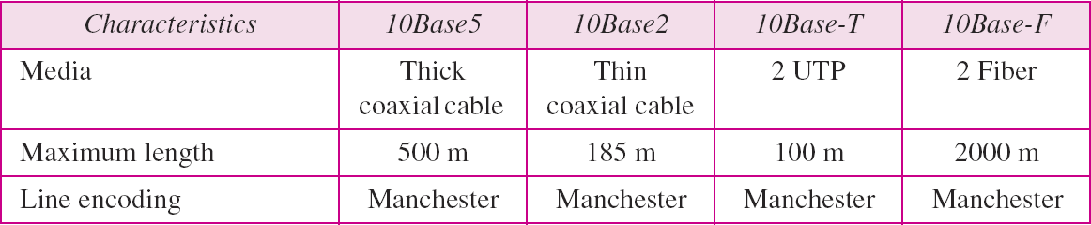
Summary of Standard Ethernet implementations

Slide 21







































CHANGES IN THE STANDARD
The 10-Mbps Standard Ethernet has gone through several changes before moving to the higher data rates. These changes actually opened the road to
the evolution of the Ethernet to become
compatible with other high-data-rate LANs.
Topics discussed in this section:
Bridged Ethernet Switched Ethernet Full-Duplex Ethernet

Slide 22
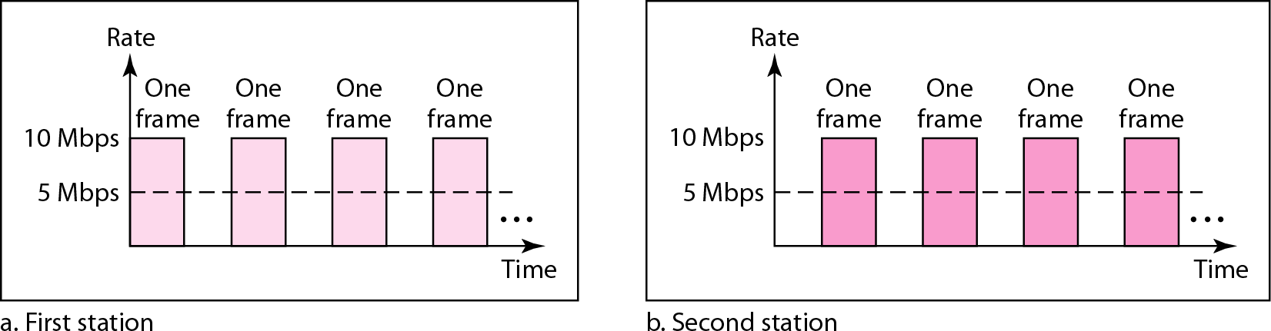
Sharing bandwidth

Slide 23
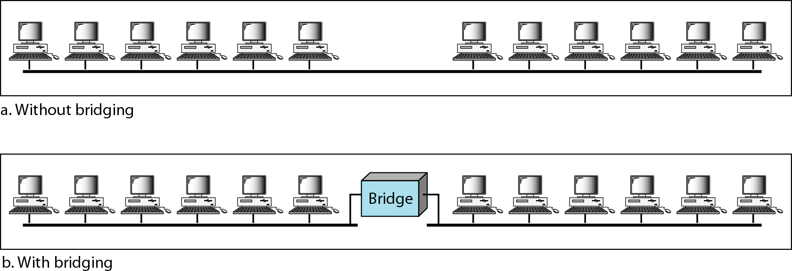
A network with and without a bridge

Slide 24
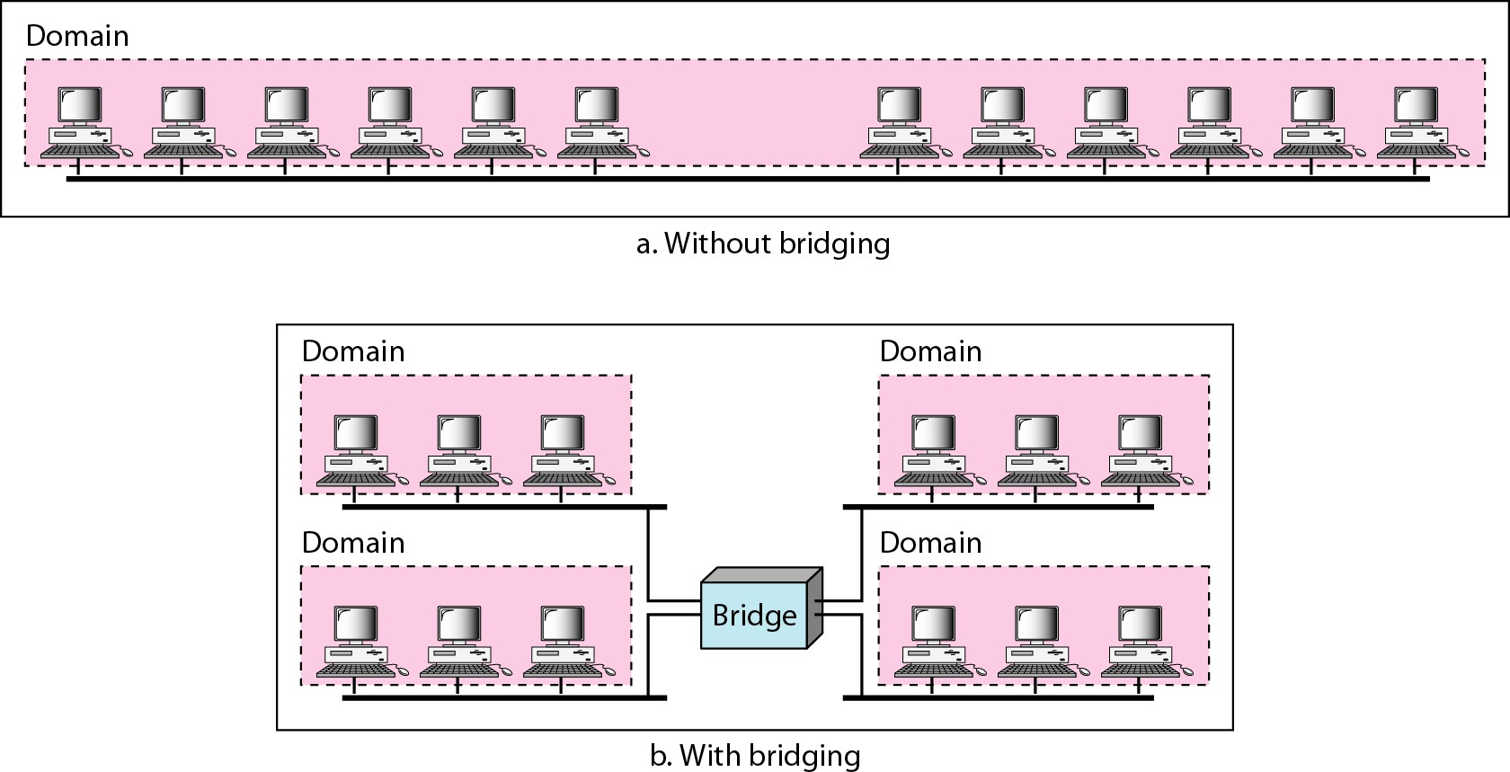
Collision domains in an unbridged network and a bridged network

Slide 25
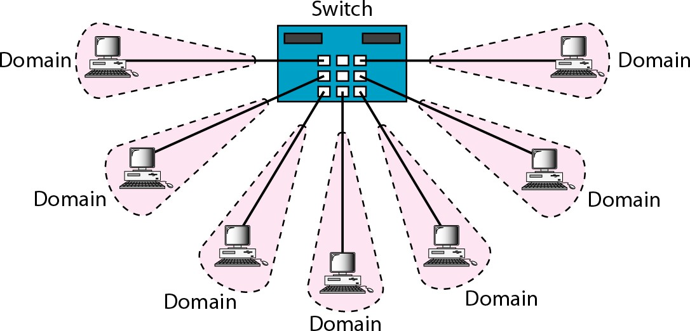
Switched Ethernet

Slide 26
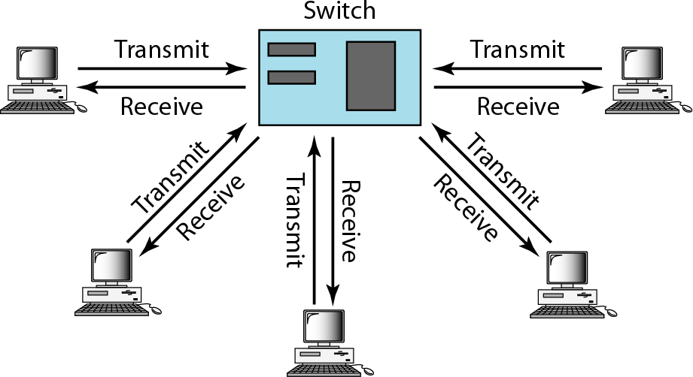
Full-duplex switched Ethernet

Slide 27






































FAST ETHERNET
Fast Ethernet was designed to compete with LAN protocols such as FDDI or Fiber Channel. IEEE created Fast Ethernet under the name 802.3u. Fast Ethernet is backward-compatible with Standard Ethernet, but it can transmit data 10 times faster at a rate of 100 Mbps.

Slide 28
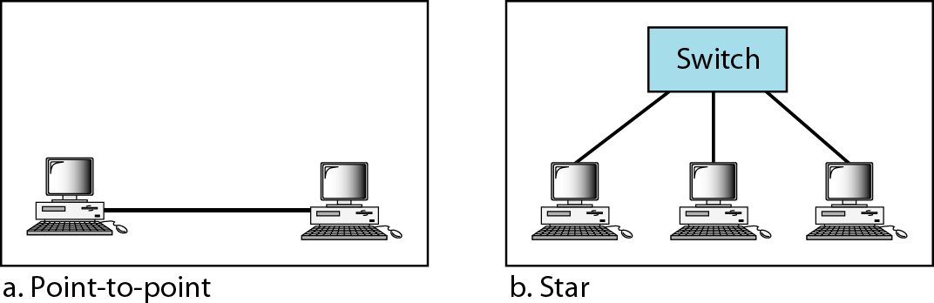
Fast Ethernet topology

Slide 29
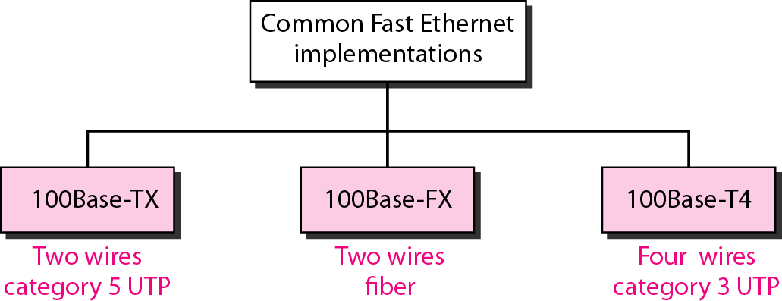
Fast Ethernet implementations

Slide 30
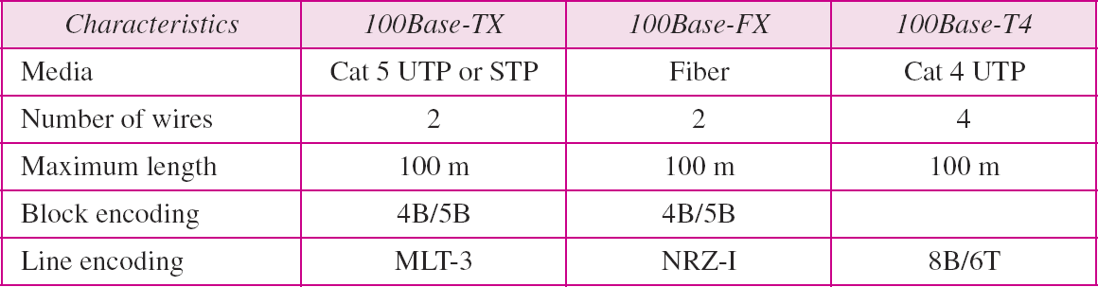
Summary of Fast Ethernet implementations

Slide 31























GIGABIT ETHERNET
The need for an even higher data rate resulted in the design of the Gigabit Ethernet protocol (1000 Mbps). The IEEE committee calls the standard 802.3z.

Slide 32
In the full-duplex mode of Gigabit Ethernet, there is no collision;
the maximum length of the cable is determined by the signal attenuation in the cable.
Note

Slide 33
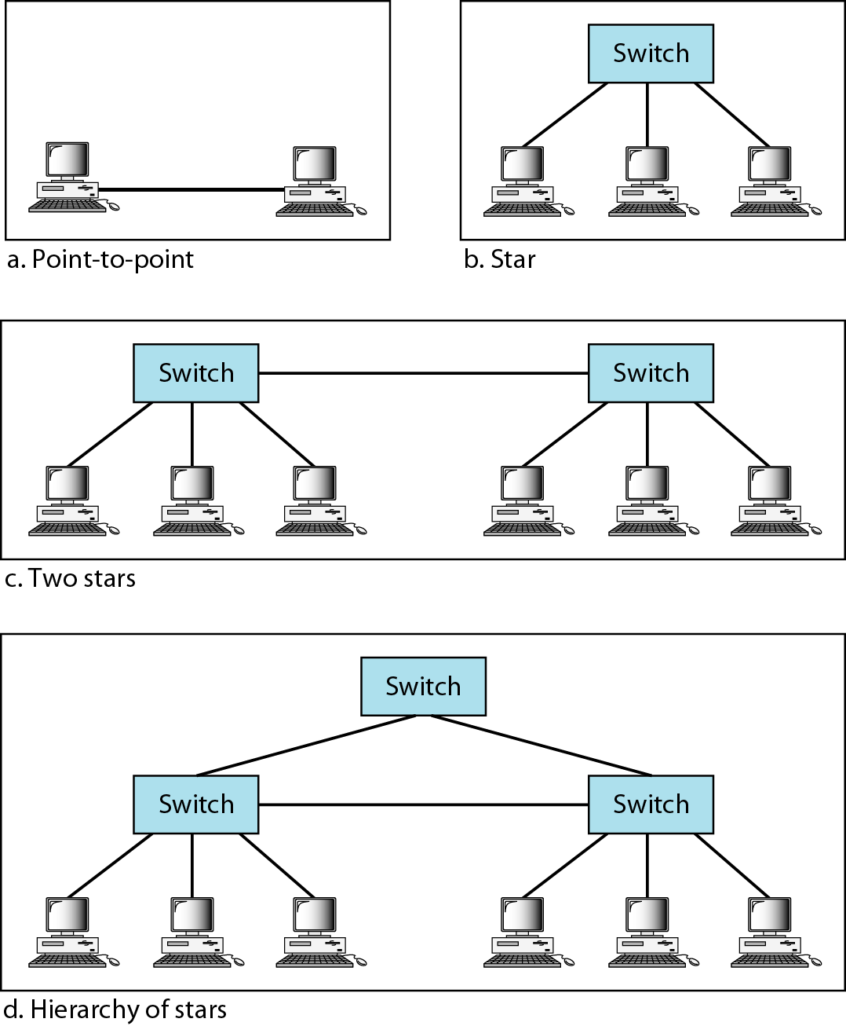
Topologies of Gigabit Ethernet

Slide 34
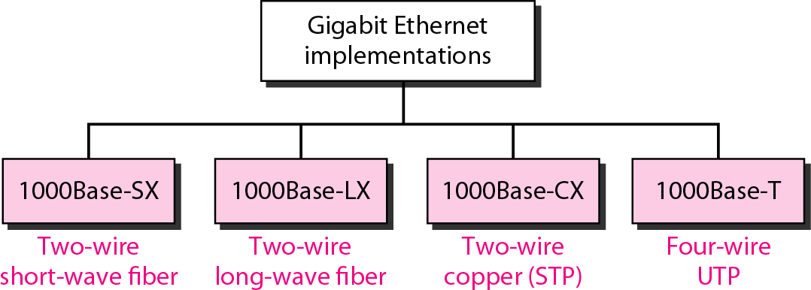
Gigabit Ethernet implementations

Slide 35
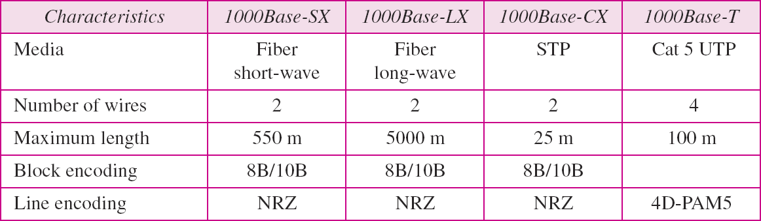
Summary of Gigabit Ethernet implementations

Slide 36
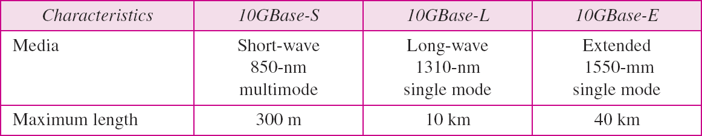
Summary of Ten-Gigabit Ethernet implementations

Slide 37
THANK YOU FOR YOUR ATTENTION

